Slide 1
COMPUTER GRAPHICS | REAL-TIME APPLICATION PROJECT
3D Building Visualization Using Depth-Based Rendering
Concept: Painter's Algorithm - Alliance University Administrative Block in Blender
NAME
REG. NO.
COURSE
SUBJECT
FACULTY
Allen Christ A
2411021061266
B.Tech IT (AR/VR)
Computer Graphics (E1CSA 377)
Dr. Shekhar R

Slide 2
OVERVIEW
Project brief
PROJECT TITLE
3D Building Visualization Using Depth-Based Rendering
CG CONCEPT
Painter's Algorithm
OBJECTIVE
To use depth sorting for rendering a complex building model.
EXPECTED OUTCOME
A building visualization demonstrating polygon ordering and visibility.
Allen Christ A | 2411021061266 | Computer Graphics, E1CSA 377
2

Slide 3
PRINCIPLE
How the Painter's Algorithm works
A painter covers the canvas back to front: background first, nearer objects painted over it. Nothing is tested per pixel; the scene is only ordered by depth.
1
2
3
Measure
Sort
Paint
Find the centre of every object and its distance from the camera.
Order all objects from farthest to nearest.
Draw in that order with the depth test OFF; later draws overwrite earlier ones.
Limitation: it fails on cyclic overlap and intersecting polygons, which is why a Z-buffer is used in real GPUs.
Allen Christ A | 2411021061266 | Computer Graphics, E1CSA 377
3

Slide 4
METHOD
Implementation in Blender
Model built procedurally in Blender Python: boxes, cylinders, spheres and tiled roofs.
1,584 separate objects, about 1.04 lakh triangles.
Objects sorted by centre distance each frame in about 0.5 to 1.1 ms.
Keys: Space = sort ON/OFF, Z = Z-buffer, 1 to 6 = camera views.
for obj in scene:
obj.dist = |obj.centre - camera|
order = sorted(scene,
key = dist, reverse = True)
depth_test(OFF)
for obj in order: # far -> near
draw(obj)
Allen Christ A | 2411021061266 | Computer Graphics, E1CSA 377
4

Slide 5
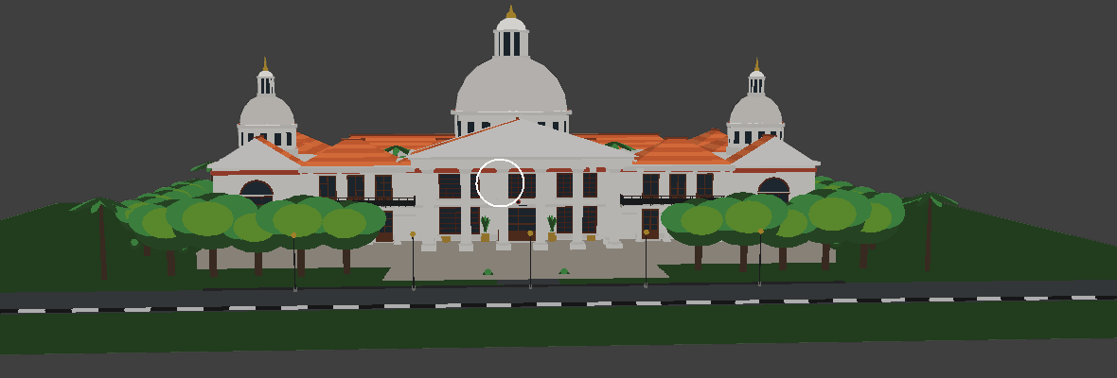
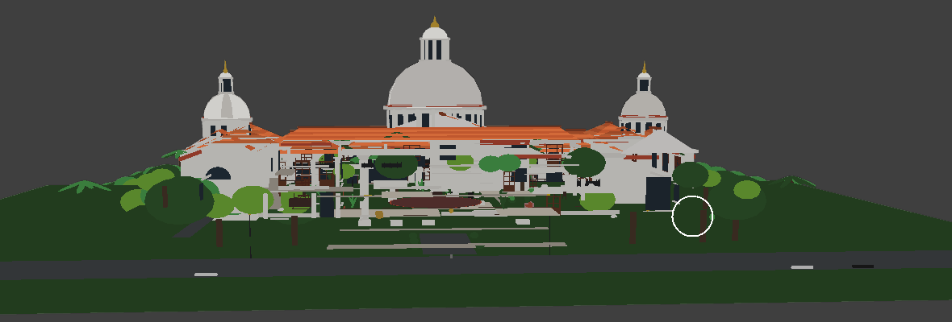
RESULT
Sorting ON versus OFF
Painter sort ON, Z-buffer OFF
Painter sort OFF (scrambled order)
Far-first order gives a correct building.
Far walls and roofs paint over near ones.
Same scene, same camera. Only the draw order changes, so the order alone decides what is visible.
Allen Christ A | 2411021061266 | Computer Graphics, E1CSA 377
5

Slide 6
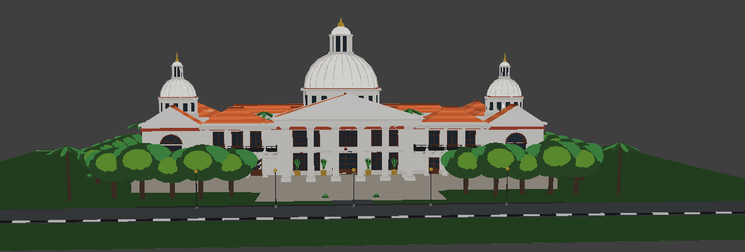
RESULT
Painter's sort compared with the Z-buffer
Painter sort ON, Z-buffer OFF
Z-buffer ENABLED
Depth from draw order.
Depth resolved per pixel by the GPU.
Both give a correct picture here. The Z-buffer is exact for every pixel; the painter sort is simpler but approximate.
Allen Christ A | 2411021061266 | Computer Graphics, E1CSA 377
6

Slide 7
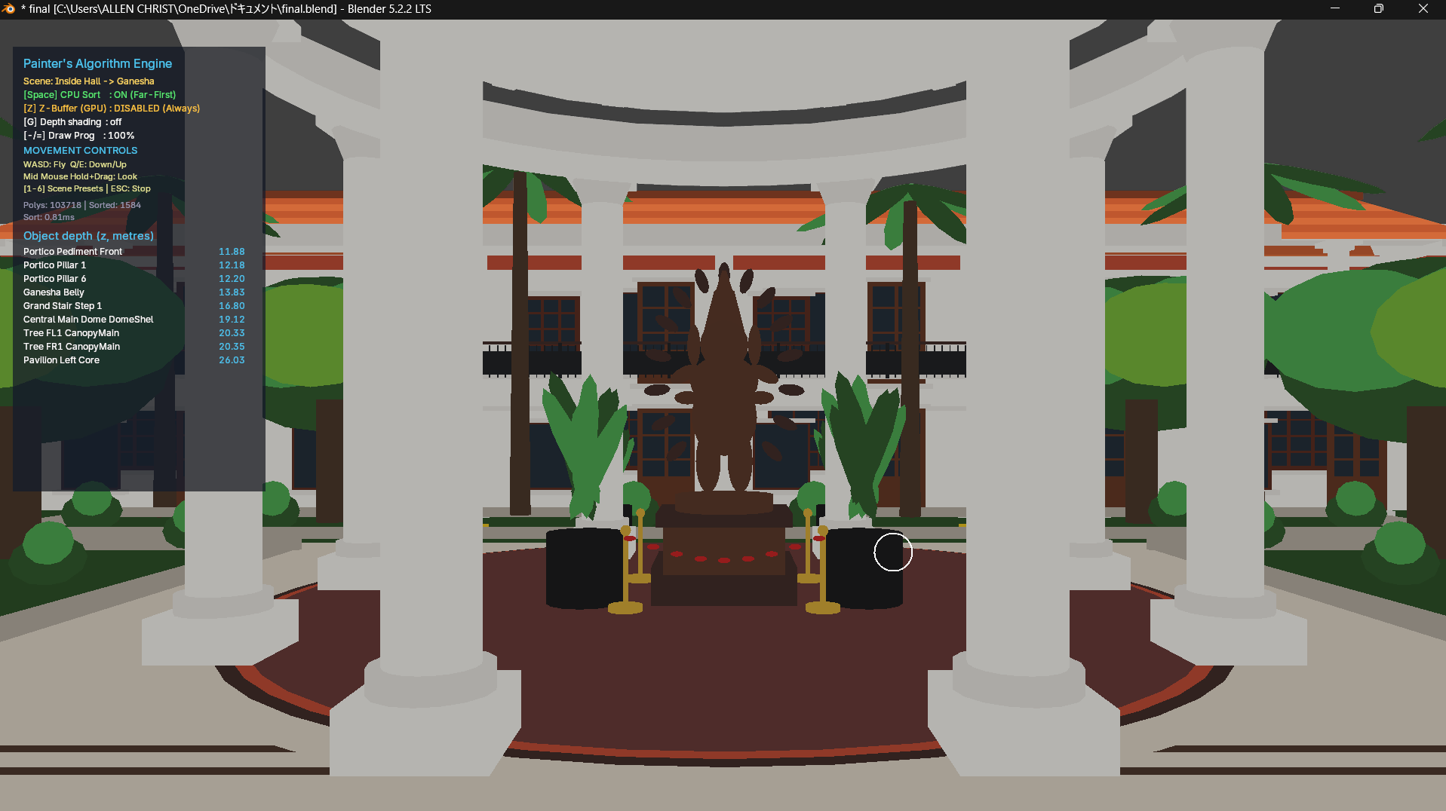
RESULT
Inside the admin block
View from the entrance hall towards the Ganesha rotunda.
Rendered with sorting ON and Z-buffer OFF, 1,584 objects.
The statue, columns, plants and the balcony galleries stack correctly because nearer objects are drawn last.
Allen Christ A | 2411021061266 | Computer Graphics, E1CSA 377
7

Slide 8
SUMMARY
Observations and conclusion
Sorting by centre distance is cheap and gives a correct image for most of the building.
Large walls and slabs must be split into small pieces, otherwise their centre misleads the order.
Fine detail such as windows needs a small bias so it is drawn after its wall.
Painter's Algorithm cannot handle cyclic overlap or intersecting polygons; the Z-buffer can.
The project shows how polygon ordering alone decides visibility in a complex 3D model.
Allen Christ A | 2411021061266 | Computer Graphics, E1CSA 377
8

